Slide 1

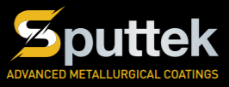
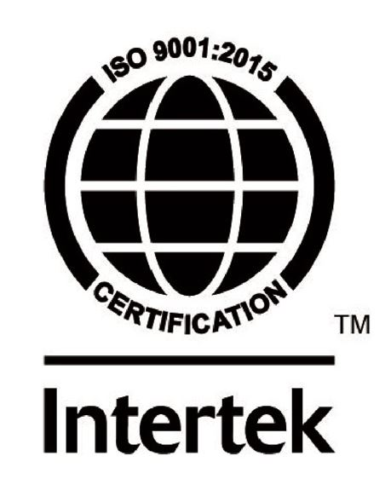
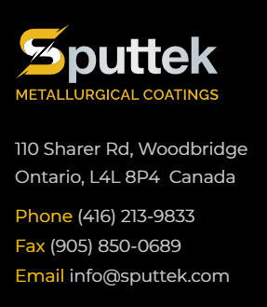
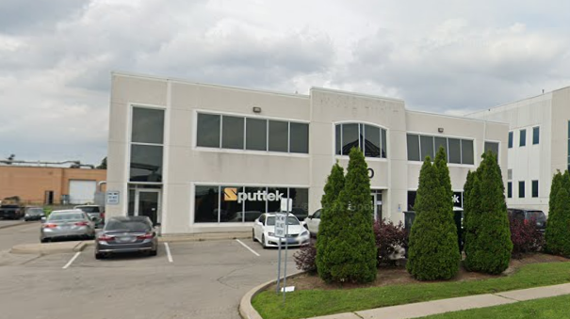
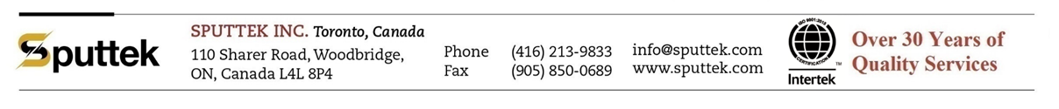
Established in 1994, Sputtek is known for high performance PVD coating services and coating equipment.
We provide low friction and wear resistance coatings for tooling, precision components, as well as decorative coatings.

Slide 2
Our Technology:
Our PVD technology is based on DC Cathodic Arc, Pulsed Cathodic Arc, Sputtering and their combination
Our Hybrid technological approach, efficient ionization, mechanical and electromagnetic filtering allows the deposition of the highest quality PVD coating available on the market.
We offer coating structures such as Nano Multilayer, Nano Compositions or based on high entropy ceramic systems. When required, we can deposit PVD coatings well in the range of 10-25 µ.
For extreme applications, we offer Direct and Inverted Duplex Processes. Our Direct Duplex Process is based on additional case hardening (30-50 µ) with our low voltage, low-pressure ion immersion nitriding.
Sputtek is an independent company developing its own unique processes, coating compositions and coating development.
We are committed to our growth through ongoing research and development as well as continuing to expand our capabilities.

Slide 3
Our Facts:
Sputtek is a leader in surface engineering technology in a variety of industries.
We are the biggest PVD coating service provider in Canada.
We have additional capabilities/equipment for Duplex Process, Nitriding, Testing and failure analysis including a complete lab for examination and developing new coatings.
All R&D activities, including developments of new technologies are done under one roof including engineering and technical department.
We design and build our own machines. This gives us the flexibility and control over our process and can significantly shorten any downtime in our facility compared to our competitors.
We develop our own recipes for coatings and have full control over performance, reliability and repeatability of the process.

Slide 4
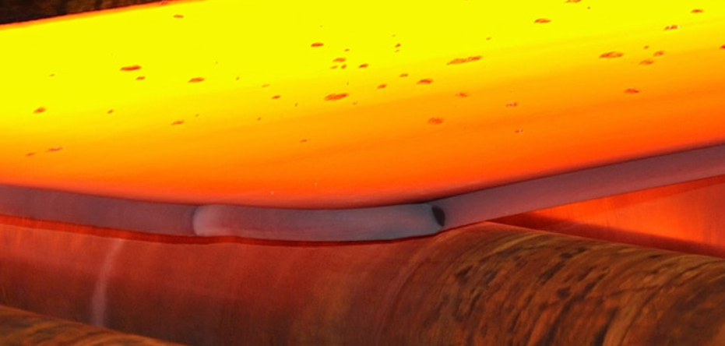
Hot Sheet Stamping Application
Hot sheet forming, also known as hot stamping or hot forming, is a manufacturing process used to shape and strengthen metal sheets at elevated temperatures. It involves heating the sheet metal and then pressing it into a desired shape using a mold. Hot sheet forming has several advantages and disadvantages, which are outlined in this presentation.

Slide 5
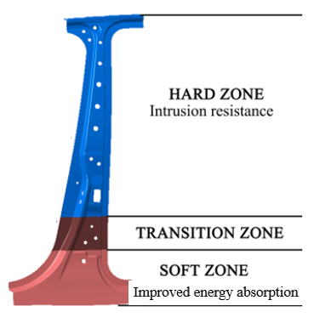
Advantages of Hot Sheet Forming:
Increased Strength:
  One of the primary advantages of hot sheet forming is the improved strength and hardness of the formed parts. Heating the metal above its recrystallization temperature allows for greater plasticity, enabling the material to be formed into complex shapes without cracking or deformation. The resulting parts exhibit higher strength and improved mechanical properties compared to cold-formed parts.
1,000 – 1,500 MPa

Slide 6
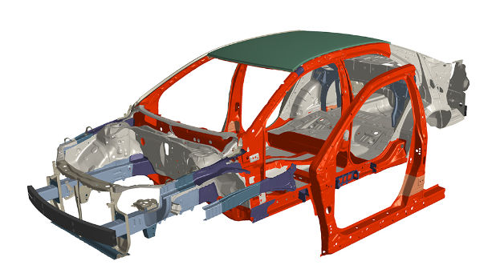
2. Lightweight Design:
  Hot sheet forming allows for the production of lightweight components with complex geometries. The process enables the use of high-strength steels, which have a higher strength-to-weight ratio compared to conventional steels. This allows manufacturers to reduce the weight of components while maintaining or even enhancing their structural integrity.

Slide 7
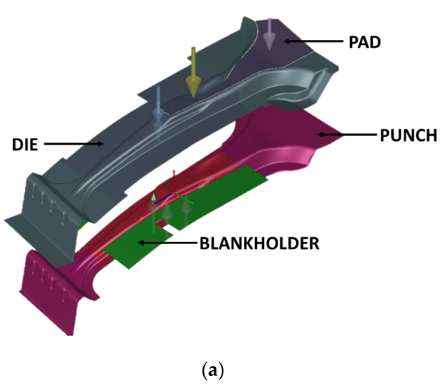
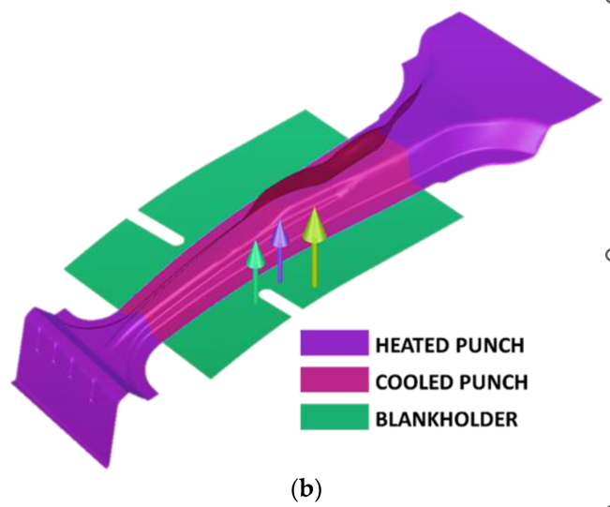
3. Tailored Properties:
  The elevated temperatures during hot sheet forming facilitate the manipulation of material properties. By carefully controlling the heating and cooling rates, it is possible to create components with tailored mechanical properties, such as different levels of hardness or strength in specific areas. This can be particularly advantageous for applications that require localized reinforcement or areas of varying toughness.

Slide 8
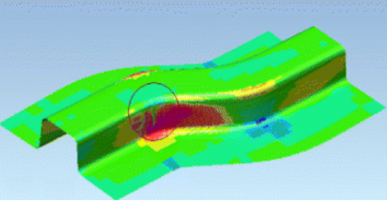
Improved Formability:
  Hot sheet forming increases the formability of the metal sheets, making it easier to produce parts with complex shapes and tight tolerances. The material becomes more ductile, reducing the risk of defects such as wrinkling, tearing, or springback that can occur during cold forming processes. This leads to higher dimensional accuracy and a reduced need for secondary operations.

Slide 9
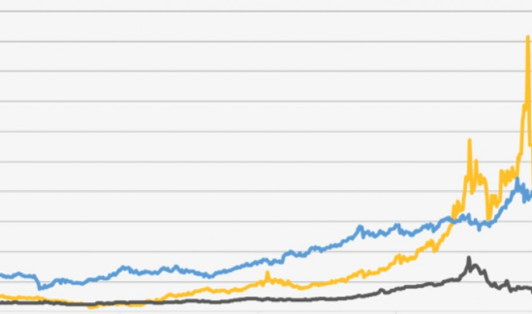
Disadvantages of Hot Sheet Forming:
Equipment and Energy Costs:
  Hot sheet forming requires specialized equipment, including heating furnaces and presses capable of withstanding high temperatures and pressures. The setup and maintenance costs associated with such equipment can be significant. Additionally, the process consumes more energy compared to cold forming methods due to the need for heating the metal sheets.

Slide 10
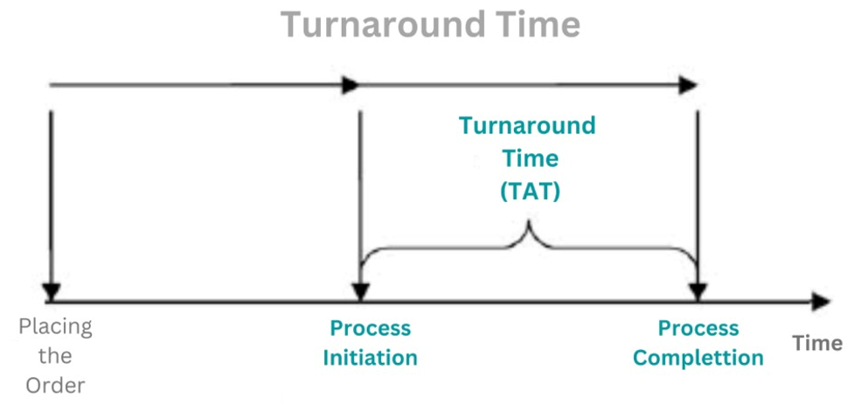
Longer Cycle Times:
  Hot sheet forming typically has longer cycle times compared to cold forming processes. The time required for heating and cooling the metal sheets adds to the overall production time. This can be a disadvantage when quick turnaround is essential for certain manufacturing operations.

Slide 11
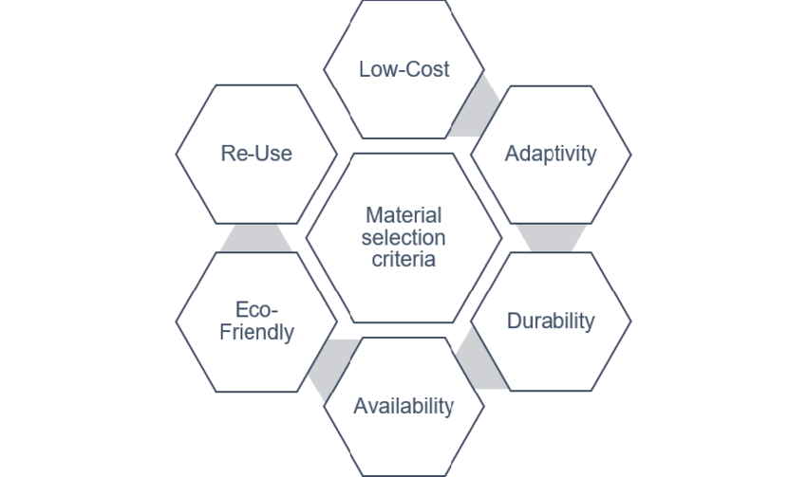
Limited Material Selection:
  Hot sheet forming is best suited for certain types of materials, particularly high-strength steels. While these steels offer excellent strength-to-weight ratios, they may not be the most cost-effective option for all applications. Additionally, some materials may undergo undesirable changes in their properties when subjected to high temperatures, limiting the range of materials suitable for hot sheet forming.

Slide 12

Complex Process Control:
  The elevated temperatures and varying cooling rates in hot sheet forming require precise process control to ensure consistent results. Factors such as temperature, heating time, and cooling rate must be carefully controlled to avoid issues like thermal gradients, distortion, or residual stresses in the formed parts. This complexity can increase production costs and require skilled operators.

Slide 13
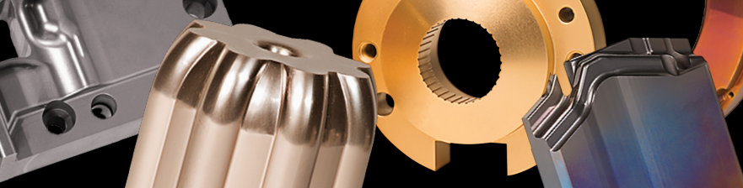
It's important to note that the advantages and disadvantages of hot sheet forming can vary depending on the specific application and requirements. Manufacturers need to carefully evaluate the characteristics of their components and production needs to determine if hot sheet forming is the most suitable process for their particular case.
FormAll-Moly, PVD (Physical Vapor Deposition) coating offers several advantages in hot sheet forming applications. Here are some of the key advantages:

Slide 14
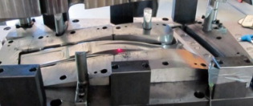
Increased tool life:
  FormAll-Moly coating provides a hard and wear-resistant surface layer on the forming tools. This improves the tool's durability and reduces wear during the hot sheet forming process. As a result, the tools last longer, leading to reduced downtime for tool changes and increased productivity.
2. Enhanced surface properties:
FormAll-Moly coating can improve the surface properties of the forming tools, such as reducing friction and enhancing lubricity. The coating creates a smooth and low-friction surface, allowing for easier sheet metal flow during forming. This reduces the risk of sticking, galling, and adhesion between the tool and the workpiece, resulting in improved part quality and reduced scrap rates.

Slide 15
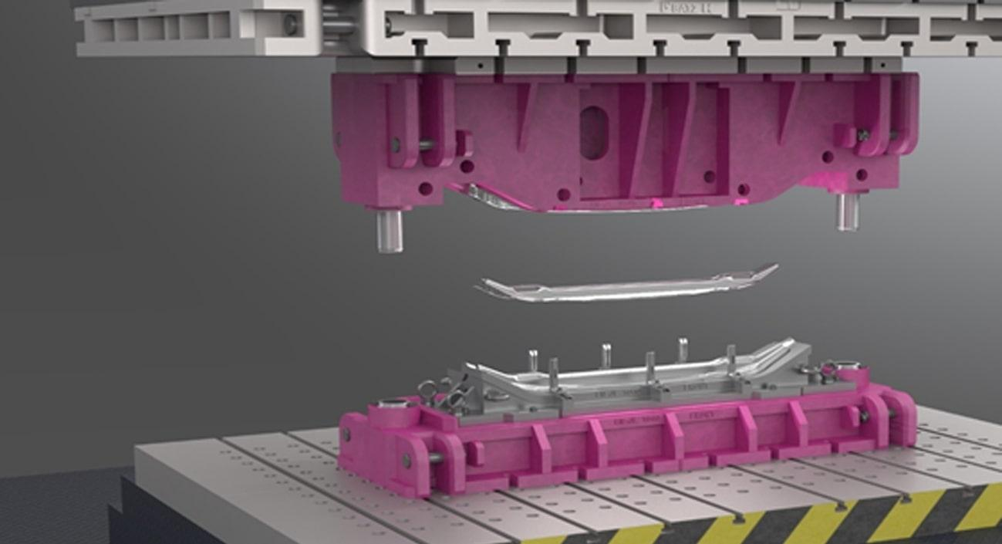
3. Thermal stability:
Hot sheet forming involves high temperatures that can cause thermal degradation and oxidation of the forming tools. FormAll-Moly coating provides excellent thermal stability, protecting the underlying tool material from heat-induced damage. This allows the tools to withstand prolonged exposure to elevated temperatures without significant degradation, ensuring consistent performance over time.
FormAll-Moly with thickness of 8-12 µ not only helps with protecting the surface, but also will generate elements that will create additional lubrication under heat.

Slide 16

4. Chemical resistance:
FormAll-Moly coating exhibits high chemical resistance, which is particularly beneficial in hot sheet forming applications where the forming process involves contact with reactive materials or aggressive chemicals. The coating acts as a barrier, preventing chemical reactions between the tool and the workpiece material, thereby improving the tool's resistance to corrosion and chemical wear.
5. Improved release properties:
FormAll-Moly can enhance the release properties of the forming tools, enabling easy and clean release of the formed parts. The low-friction surface of the coating reduces the adhesion between the tool and the workpiece, facilitating the removal of the formed parts without sticking or deformation. This contributes to improved efficiency and reduced downtime during the forming process.

Slide 17
6. Versatility:
FormAll-Moly coating can be applied to a wide range of tool materials, including steels, carbides, and ceramics. This versatility allows manufacturers to choose the most suitable tool material for their specific hot sheet forming applications while still benefiting from the advantages offered by the coating. In addition, FormAll-Moly offers a similar coefficient of expansion as steel which makes it suitable for hot stamping applications eliminating any delamination.
Overall, the application of FormAll-Moly coating in hot sheet forming applications provides extended tool life, improved surface properties, enhanced thermal stability, chemical resistance, better release properties, and increased process efficiency. These advantages lead to cost savings, improved productivity, and higher quality formed parts.

Slide 18
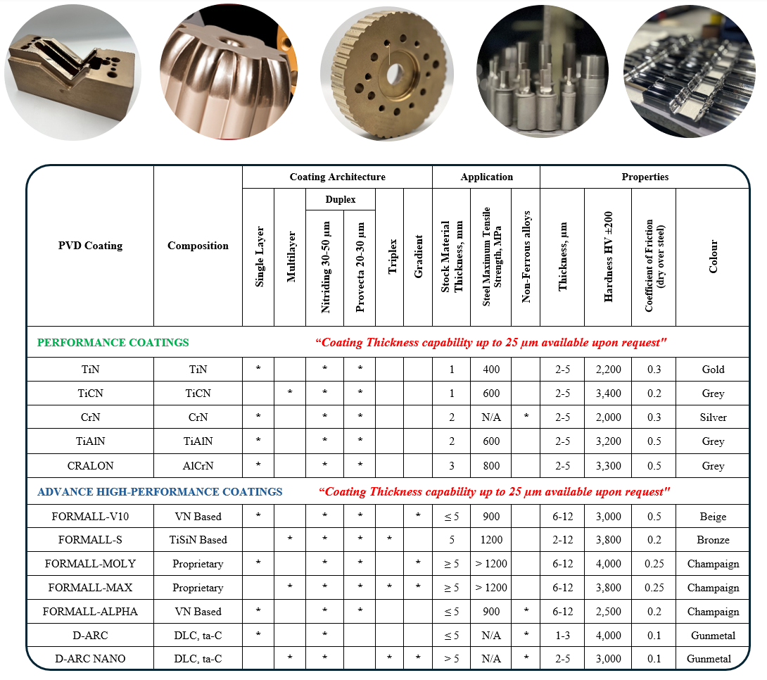

Slide 19
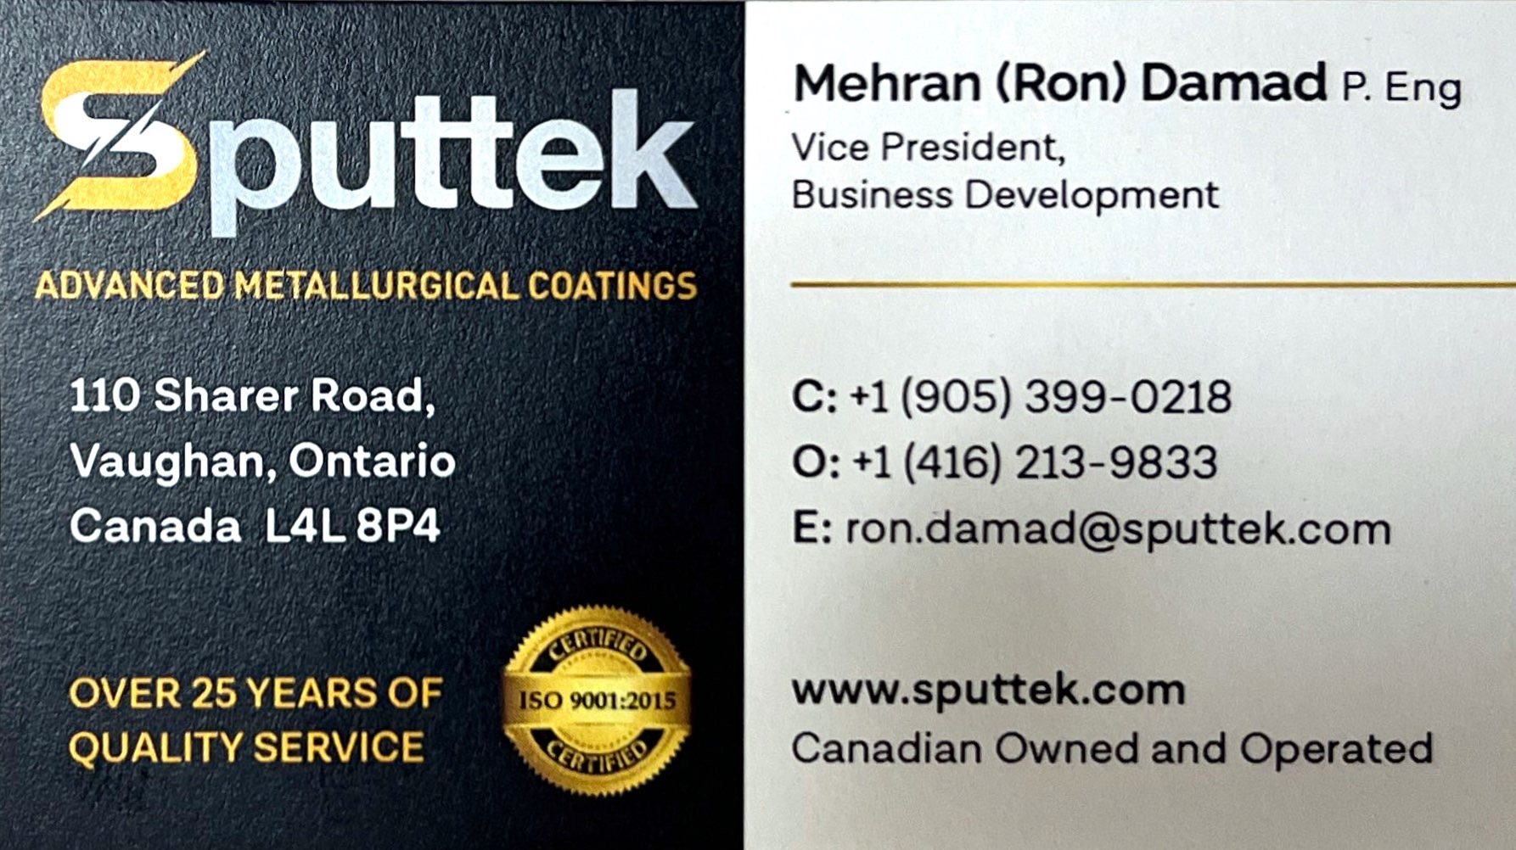
Thank you!

