Slide 1




Introducing Provecta Duplex technology
Formall family of pvd coatings

Slide 2

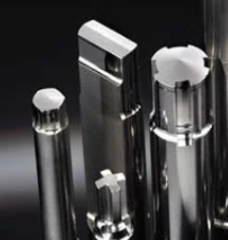
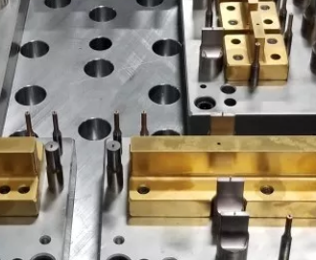
Stamping the future of pvd technology
High Wear Resistance
Lower Coefficient of Friction
Less Tool Maintenance
Lower Risk of Delamination
Increased Hardness of Diffused Layer
Suitable For UHSLA Application
Extra Toughness

Slide 3


Formall family of PVD coatings
Provecta Duplex
Diffusion layer pproviding hardness up to 2,500 HV
(2-3 times higher than nitriding process) resulting in better coating support and load capacity
Coating hardness of 4,000 HV with increased toughness and coating thickness providing increased tool life
Suitable for challenging stamping applications of high strength and thicker materials

Slide 4

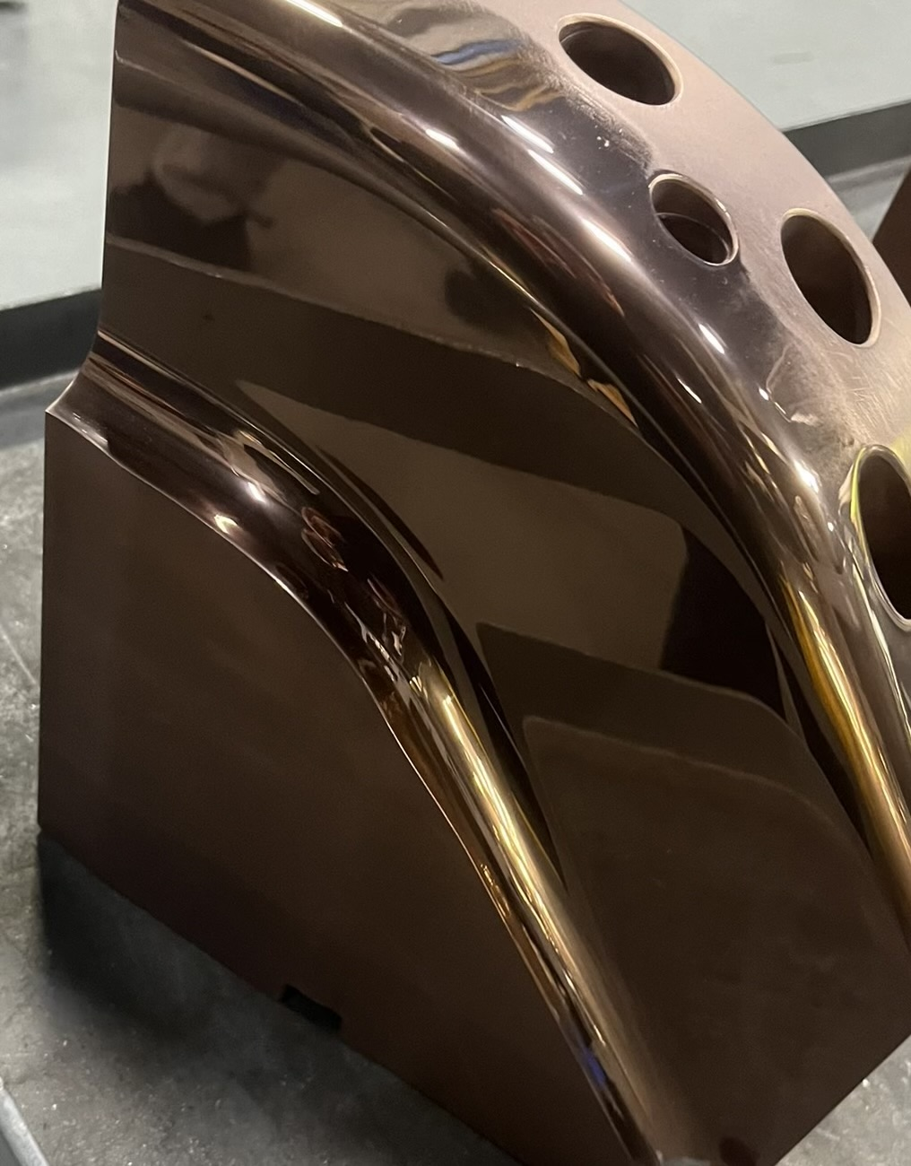

Heavy Stamping Application
Innovation from Sputtek
FormAll-S Provecta Duplex
Case Study
Material: UHSLA, 1,200 MPA
Thickness: 0.250”
Application: Forming
Industry: Automotive
Coating Hardness: 3,800 HV
Coefficient of Friction: 0.25
No of hits: 18,500
Background:
“In this challenging application, customer could reach max 10,000 hits before stopping the press to repair the forming tools. With FormAll-S Provecta* Duplex coating customer now has 85% increased tool life and productivity!

